Slide 1


Integrating Parsons Puzzle with MyUni
Project ID 27
Jialun Han
Neha Wali
Peiting Sun

Slide 2
Structure
Background.
What is Parson’s Puzzle?
Why Parson’s Puzzle?
Integrating Parsons Puzzle to MyUni.
Why our solution is better?
References.

Slide 3

Background
Programming essentials: Concepts, Logic and Syntax.
Syntax error: Ignoring or forgetting the standard convention.
E.g.: Put the food in the plate.
Semantic error: Incorrect logic.
E.g.: A rock smelled the color nine.
Syntax is okay but it has no meaning!

Slide 4
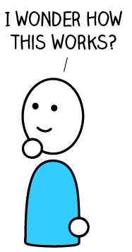
Beginners guide: (Oyelere et. al, 2017)
Clarity in fundamentals is necessary to progress.
Learning programming is difficult and boring.
Exercises are hard to motivate.
Little opportunity to practice semantics and syntax together.
Hard to convert theoretical ideas into practical solutions.

Slide 5

Problems faced by Novice programmers : (Robins et al., 2003)
Likely to concentrate on shallow knowledge.
Lack conceptual modelling skill.
Fail to incorporate pertinent knowledge for solving problem.
Difficult to remember and correctly apply vocabulary, logic, errors, syntax, semantics, and style.

Slide 6
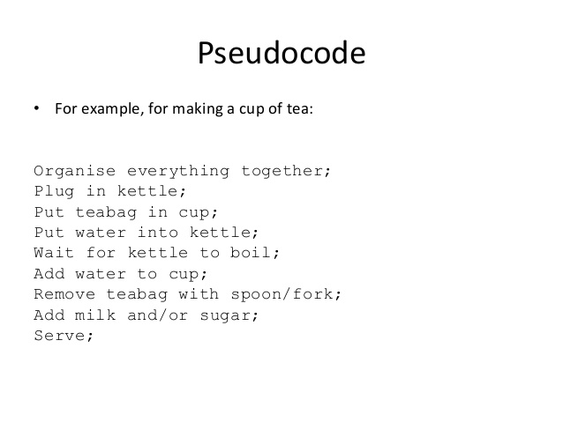
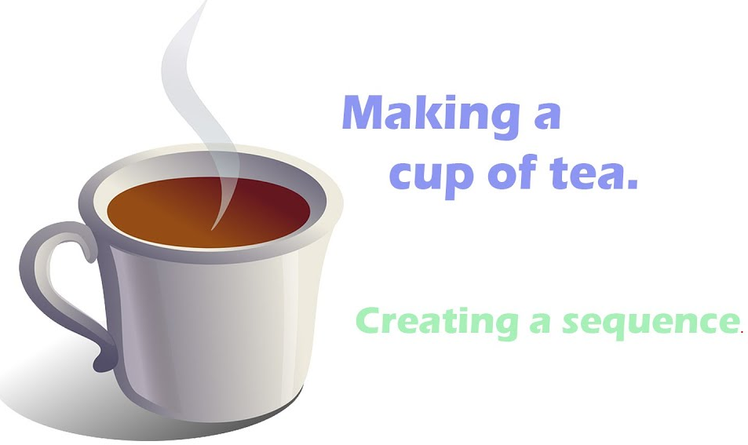
Programming follows an Algorithmic approach:
An ordered sequence of instructions

Slide 7
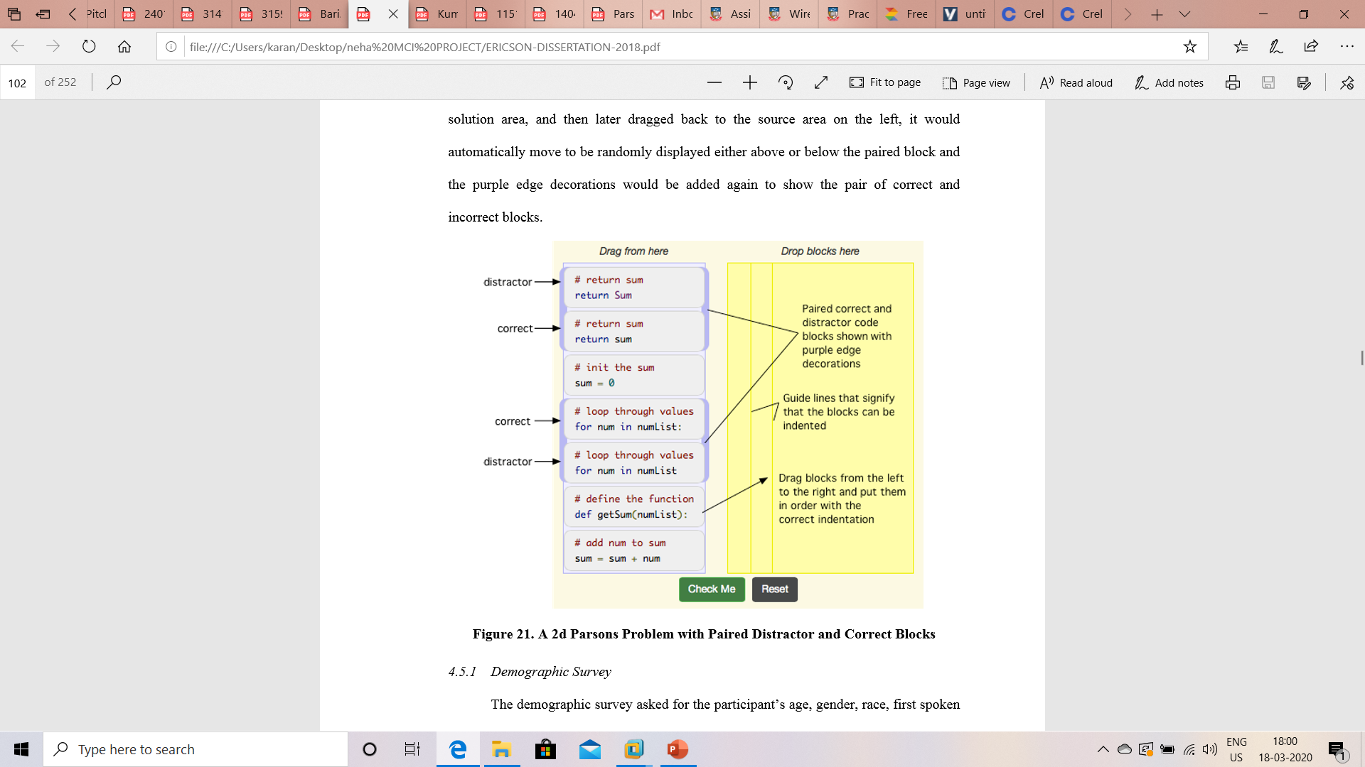
What is Parsons Puzzle ?
Small programming tasks to reconstruct program.(Kumar, 2018)
Selecting and ordering code fragments.
Designed to support learning of syntax and logic.
Teach problem solving through algorithmic thinking and visualization.

Slide 8
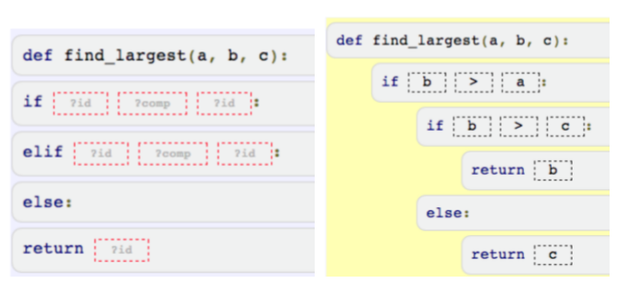
Distractors are used to make students create an error.
This helps to know about common mistakes committed.
Awareness of errors helps in avoiding it.
How to choose the largest of the three numbers?

Slide 9
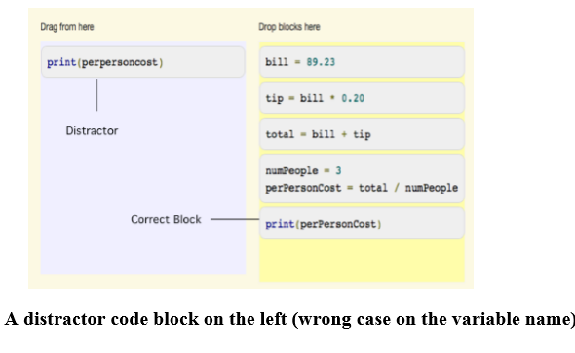
Drag code fragment from Problem panel to solution panel.
Reorder code fragment in Solution panel by moving it up or down.
Indent/outdent code fragment in Solution panel.

Slide 10
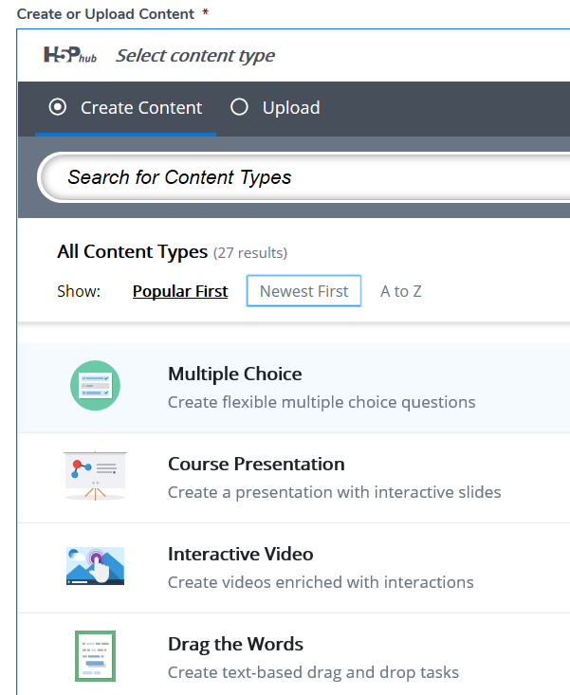
Integrating Parsons Puzzle with MyUni
Creating a new function Parsons Puzzle into H5p interface.
Ultimately integrating it to MyUni.
H5P is a free and open-source content collaboration framework based on JavaScript.
H5P aims to help everyone to create, share and reuse interactive HTML5 content.

Slide 11
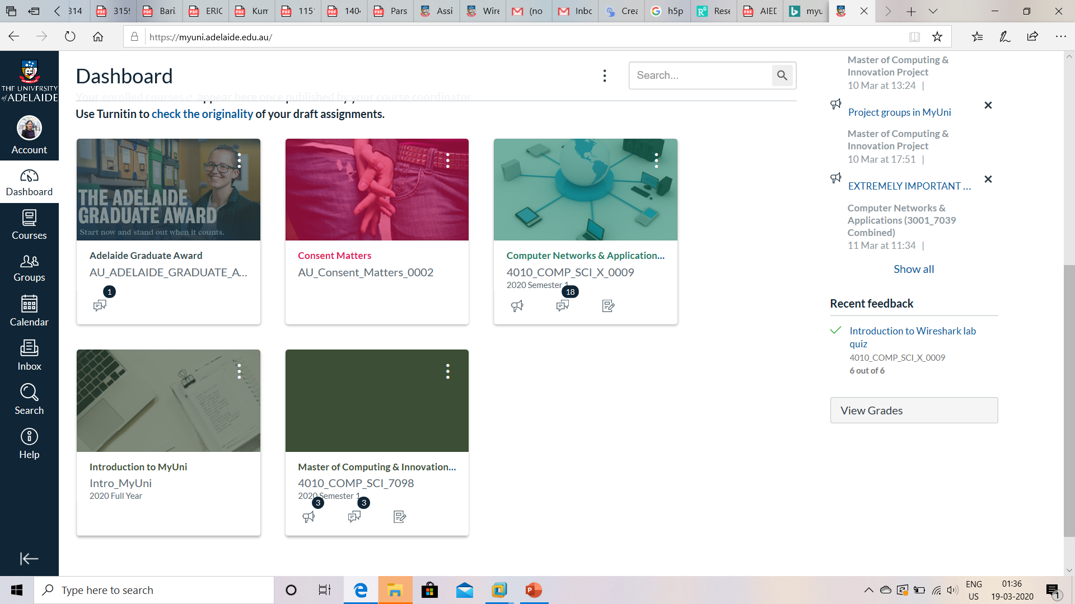
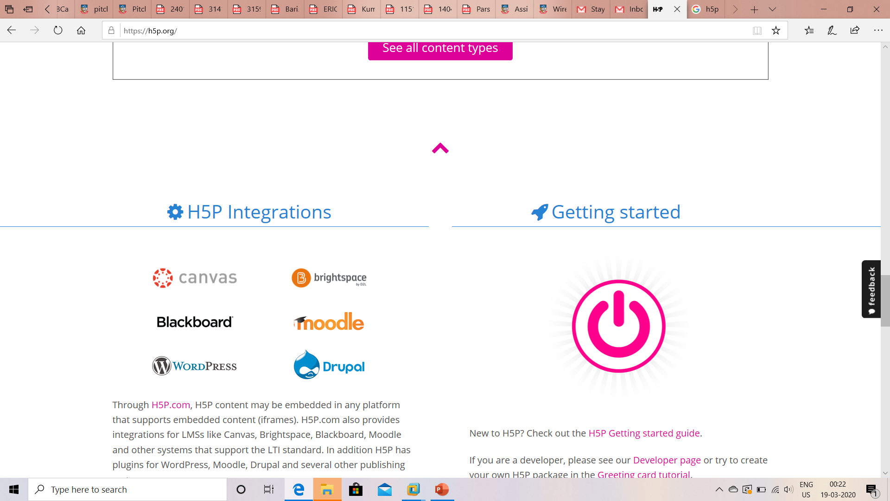
MyUni is the University of Adelaide instance of the Canvas Learning Management System (LMS).
It enables communication and collaboration between students and staff.
It provides a platform for making learning accessible to all students.
H5p integrations include canvas which is used by MyUni.

Slide 12
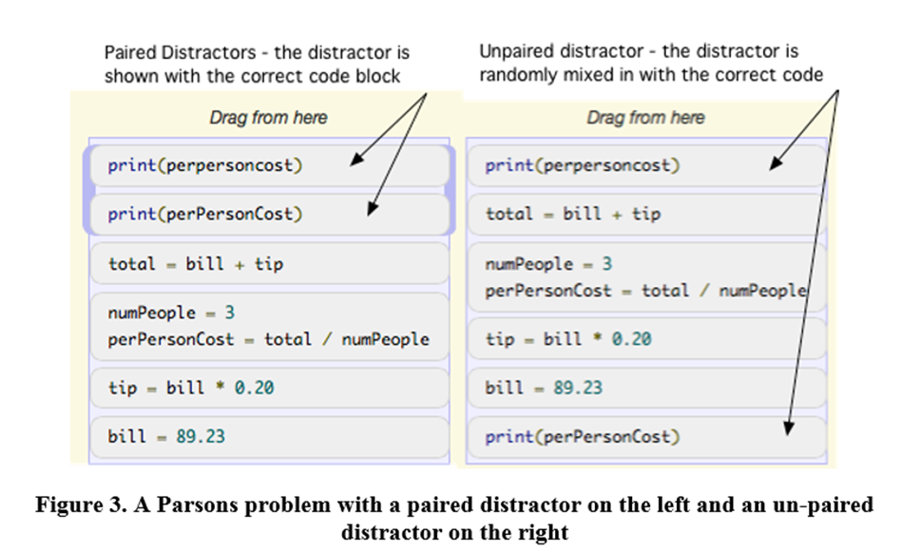
Why Parsons Puzzle ?
User interactive and engaging.
Implementing theory into practical implementation.
It reduces time and effort of students to get deeper understanding.

Slide 13
Why our solution does it better?
Creating a universal design of parson’s puzzle.
E.g.: Sequential chemical equations, Mathematical proofs.
Incorporating unique function of Parsons Puzzle into Hp5 and ultimately, MyUni.
Add the options of : Immediate and deep feedback , Time spent for each attempt, Variation of solutions.
Data collection Analysis will help to improve the education. (topics which require more focus)

Slide 14
References
A. Robins, J. Rountree and N. Rountree, "Learning and teaching programming: A review and discussion," Computer Science Education, vol. 13, pp. 137-172, 2003.
S. S. Oyelere, J. Suhonen, T. H. Laine,“Integrating Parson’s Programming Puzzles into a game-based mobile learning application”, pp. 158-162, 2017.
B. J. Ericson, “Evaluating the Efficiency and Effectiveness of Adaptive Parsons Problems”, 2018.
Amruth N. Kumar, “Epplets: A Tool for Solving Parsons Puzzles”,pp. 527-532, 2018

